Slide 1
Update on Stove & Canister Production SET UP for Test Rollout
Photos from 13 &14 Dec 2017

Slide 2
POTHOLDER

Slide 3
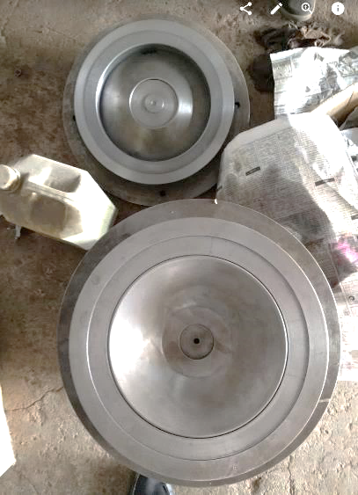
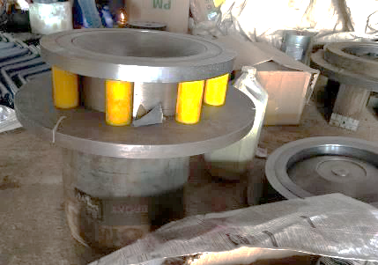
Potholder Cone
Tool: top mould
Tool: bottom mould
Mould mounts

Slide 4
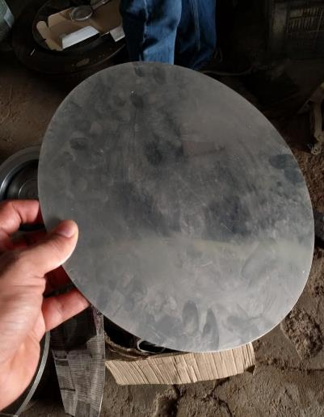
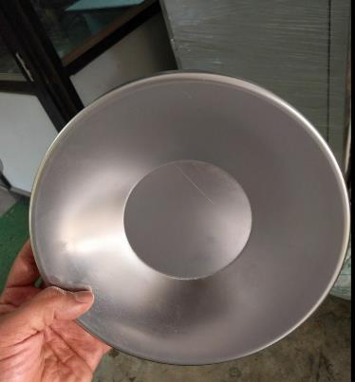
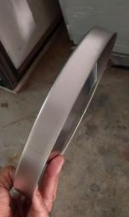
Potholder Cone
Cone – raw material (stainless steel mirror finish)
Cone – formed part (trial with brushed Stainless)

Slide 5
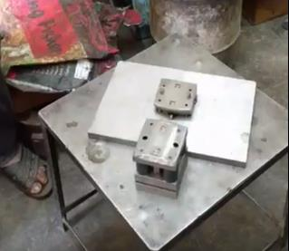
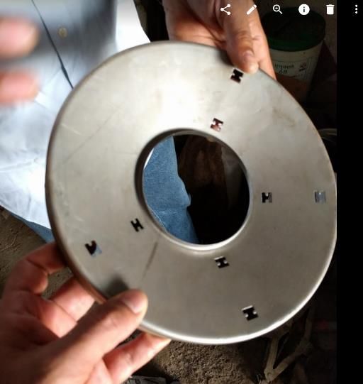
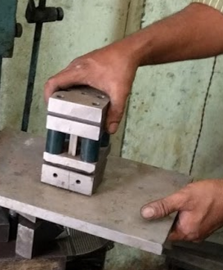
Potholder Cone: Punching holes for Pot Supports
Pot Support hole Punching tool + circular jig (5 steps)
Part (after 4 out of 5 punches)

Slide 6
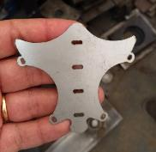
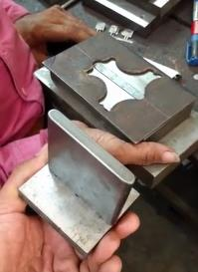
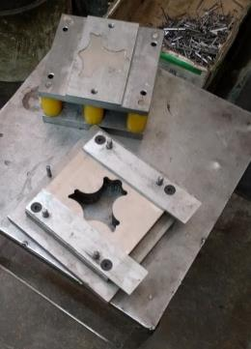
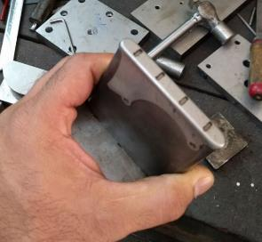
Pot Holder: Production of Pot Supports pieces
Cut part
Pot support drawing tool (needs 30 ton press)
Blanking tool cuts narrow sheet metal strip to right shape for each pot support
Completed Pot support part

Slide 7
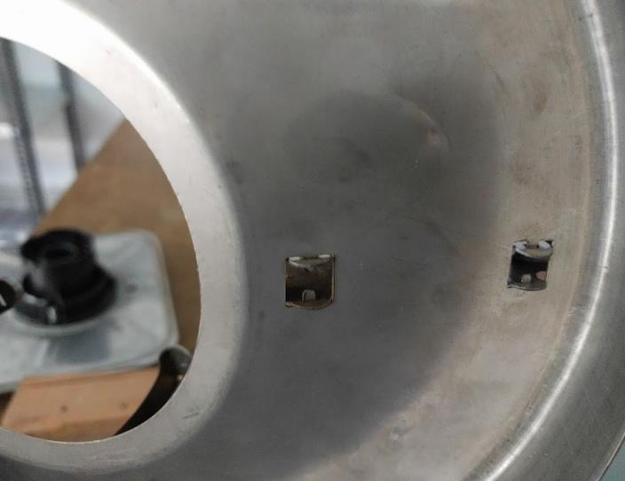
Pot Holder assembly
Pot Supports are attached to cone from rear and tabs folded

Slide 8
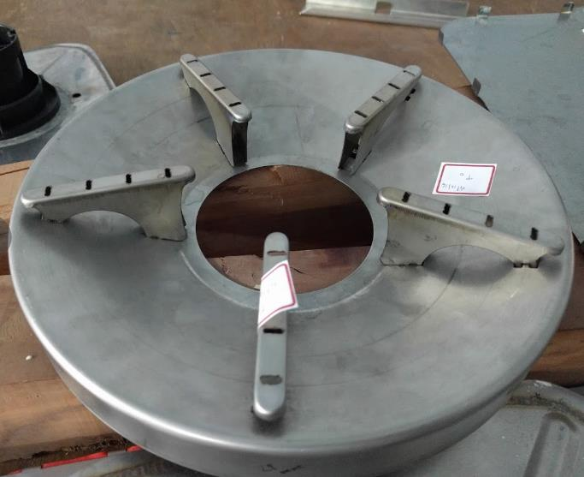
Pot Holder : Compelted Trial Unit (using older duller finish material w/ laser-cut pot support protos)
(Central rim not formed up in this test unit )

Slide 9
REGULATOR INTERLOCK MECHANISM PARTS

Slide 10
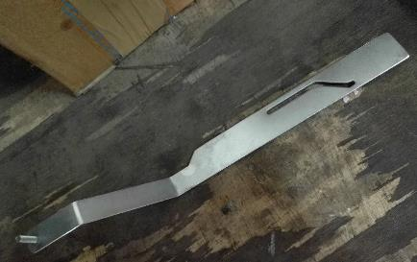
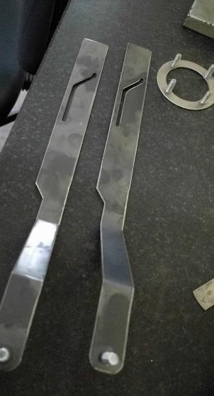
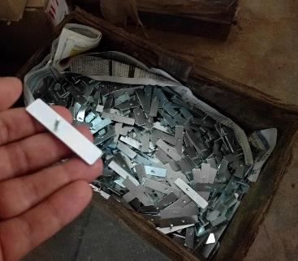
Zinc plated
Cut steel parts

Slide 11
STOVE TANK

Slide 12
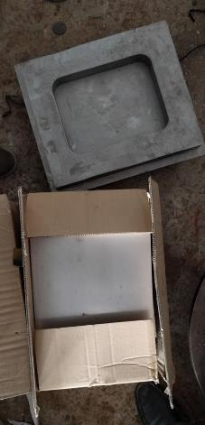
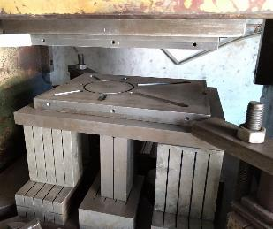
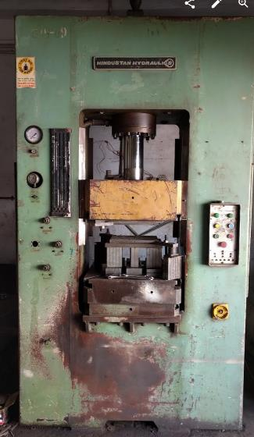
Forming of Tank Top & Bottom Parts
Tank Bottom: tool & cut raw material
Tank Top: tool mounted in hydraulic press

Slide 13
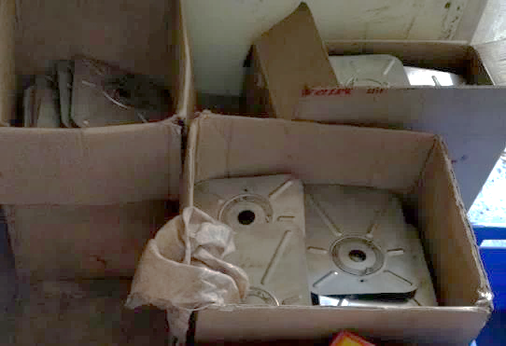
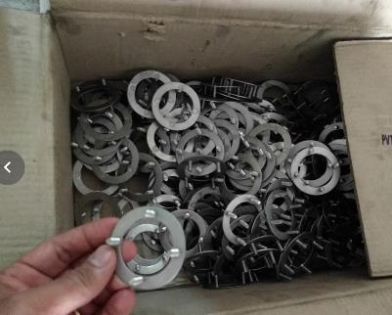
Tank Production
Produced Tank Parts
Fasteners for Plastic
Valve part

Slide 14
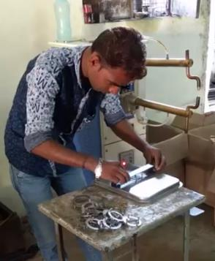
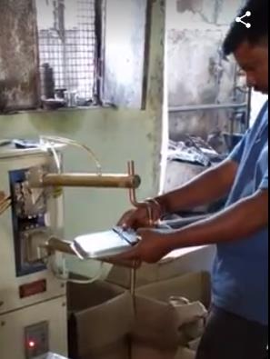
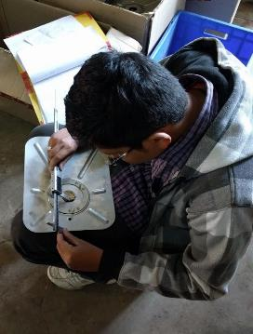
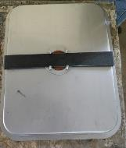
Stove Tank: Adding Fasteners for Plastic Valves to Top and Bottom Parts
Simple jig for aligning Fastener to the Tank
Spot welding Fastener in Place
Quality control

Slide 15
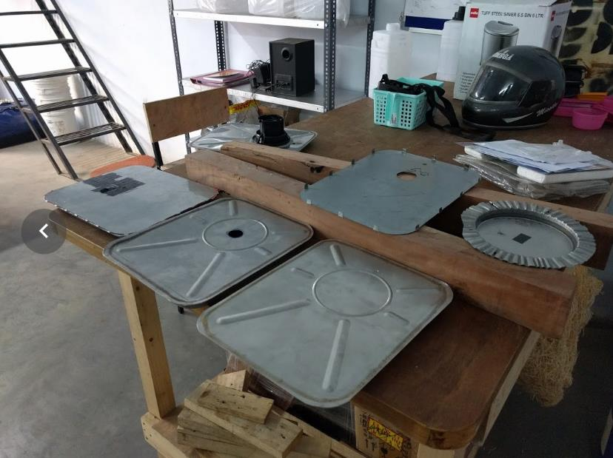
Stove Fuel Tank –Seam Welding trials

Slide 16
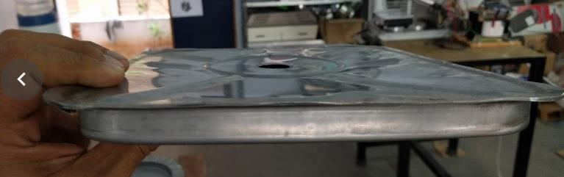
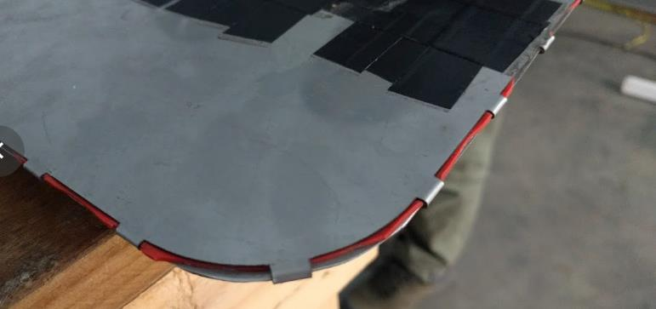
Failed Stove Fuel Tank Assembly Trials : Seam Welding with distortion (top); Gasket & Folding Tabs (bottom)

Slide 17
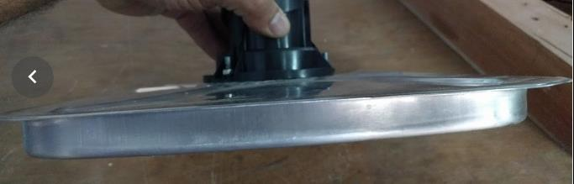
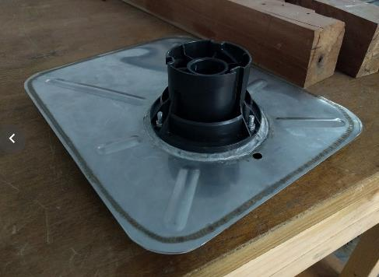
Approved Stove Fuel Tank Assembly Trial: Continuous Seam Welding (good weld, no distortion)

Slide 18
Burner assembly

Slide 19
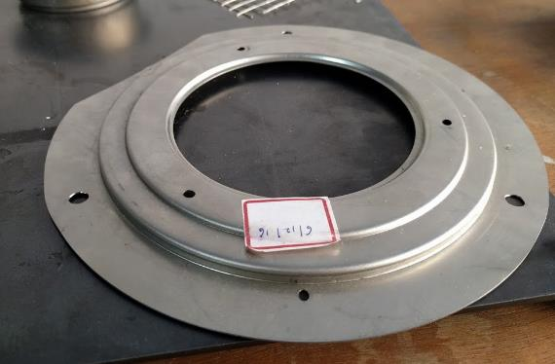
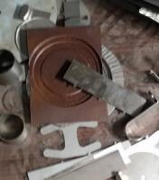
Burner Top Plate
Tool
Test part

Slide 20
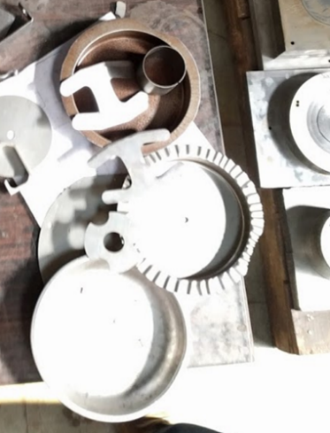
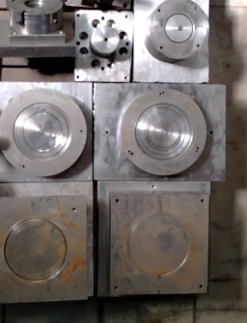
Burner Bottom & Interior Cups
Test Units
Tools

Slide 21
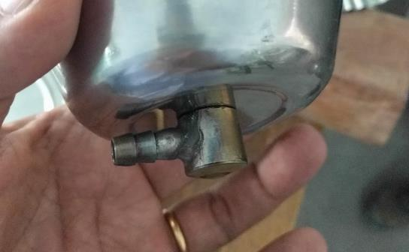
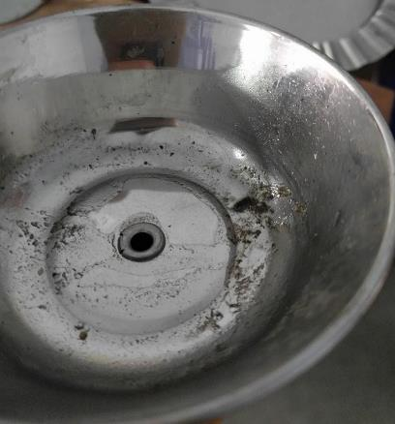
Burner Bottom – Approved method for connecting hose to bottom of burner (oring + compression flare)

Slide 22
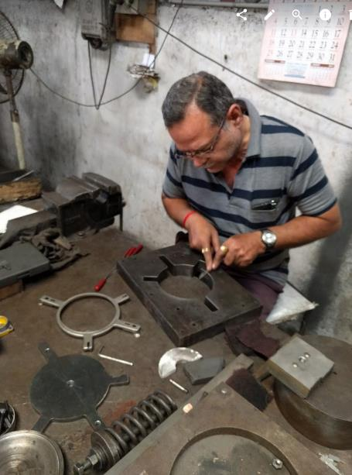
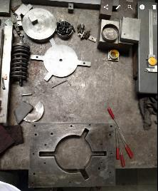
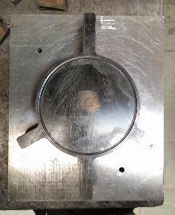
Burner Rotator Ring - minor adjustments underway
Test part
Tool

Slide 23
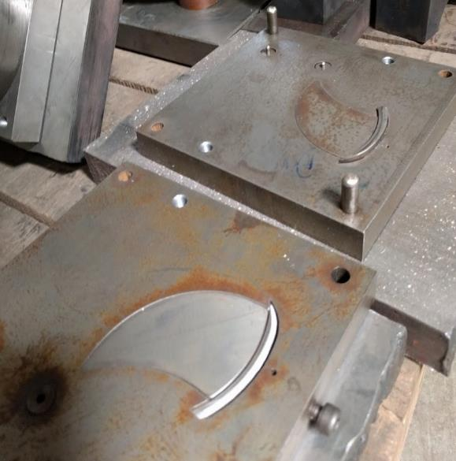
Burner petal mold
Tool

Slide 24
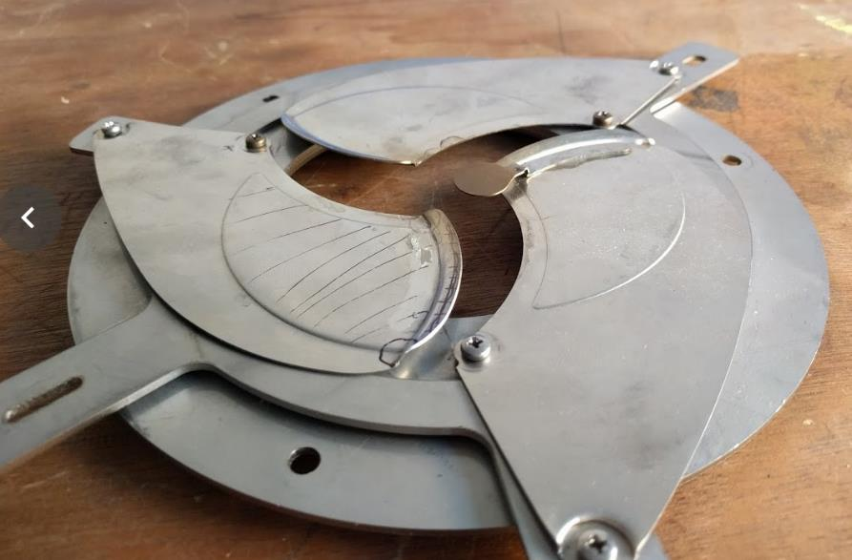
Burner Petal Test Parts mounted to old Rotator Ring & Burner Top prototypes + with Flame Snuffer

Slide 25
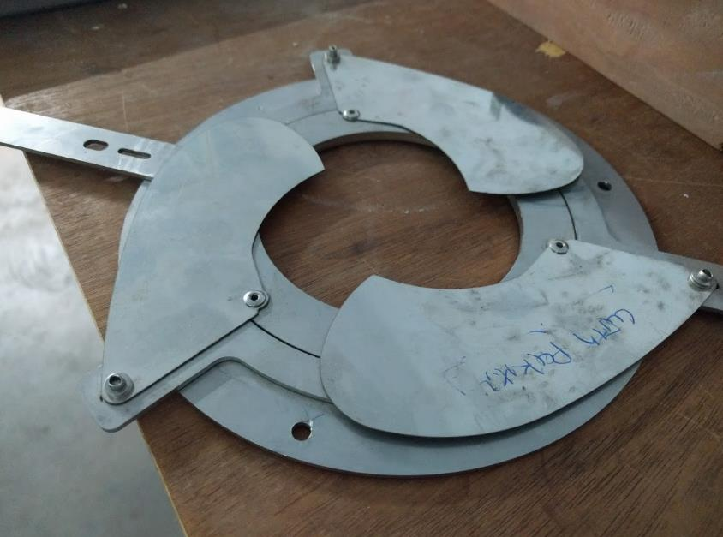
Testing spaced rivets instead of screws for fastening petals on Proto parts-- approved

Slide 26
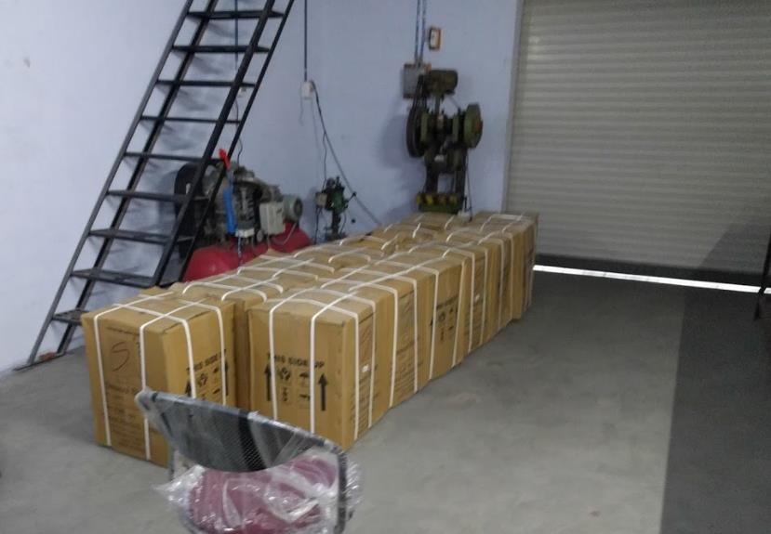
Ceramic Wool received for 600 units

Slide 27
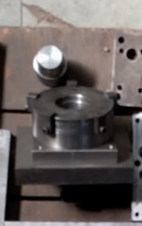
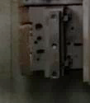
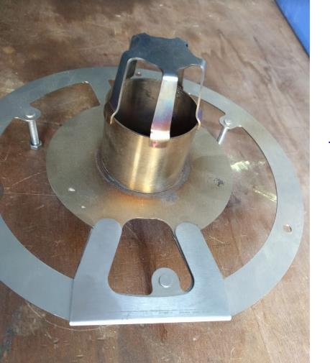
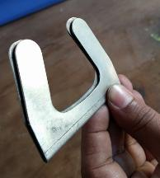
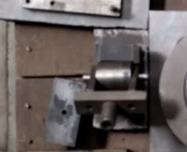
Combustion plate, Plate support & Flame Spreader,
Flame Spreader Tool & Part
Plate Support Bending Tool & Test Part
Combustion Chamber Roller Tool & Part

Slide 28
LARGE PLASTIC PARTS

Slide 29
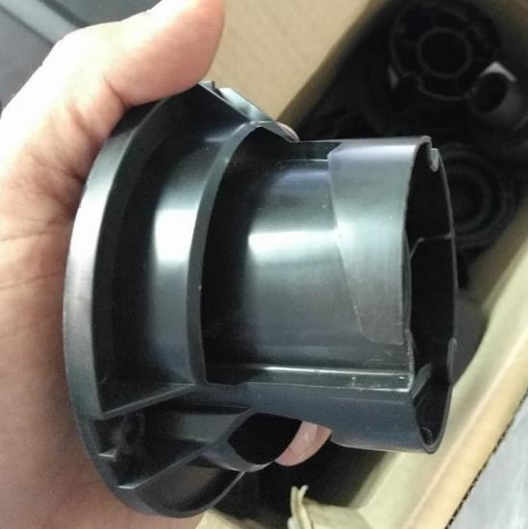

Stove Dock injection-molded from black polypropylene -- approved

Slide 30


Canister Cap injection-molded from black polypropylene -- approved

Slide 31
Other approved injection-molded parts
Pending injection-molded parts
(tools still in production)
Canister Mouth
Canister Cap
Fuel Gauge
Regulator indicators
Stove Tank Cap
Canister dock small parts (2)
Canister air valve parts (2)
Tilt valve parts (2)
Stove Tank Float
Injection-molded parts in Testing

Slide 32
RIVETS, SPACERS, NUTS & OTHER PARTS for 600 UNITS

Slide 33


Slide 34
STOVE BODIES

Slide 35



Slide 36


Black powder-coated side panels

Slide 37

232 Green Bodies completed

Slide 38
CANISTER LABEL & WELCOME MANUAL PRINTER

Slide 39

`

Slide 40


Slide 41
OTHER PHOTOS

Slide 42


Slide 43


Slide 44




Slide 45


